Slide 1
Chapter 9 Objects and Classes

Slide 2
OO Programming Concepts
Object-oriented programming (OOP) involves programming using objects. An object represents an entity in the real world that can be distinctly identified. For example, a student, a desk, a circle, a button, and even a loan can all be viewed as objects. An object has a unique identity, state, and behaviors. The state of an object consists of a set of data fields (also known as properties) with their current values. The behavior of an object is defined by a set of methods.

Slide 3

Objects
An object has both a state and behavior. The state defines the object, and the behavior defines what the object does.

Slide 4
Classes
Classes are constructs that define objects of the same type. A Java class uses variables to define data fields and methods to define behaviors. Additionally, a class provides a special type of methods, known as constructors, which are invoked to construct objects from the class.

Slide 5
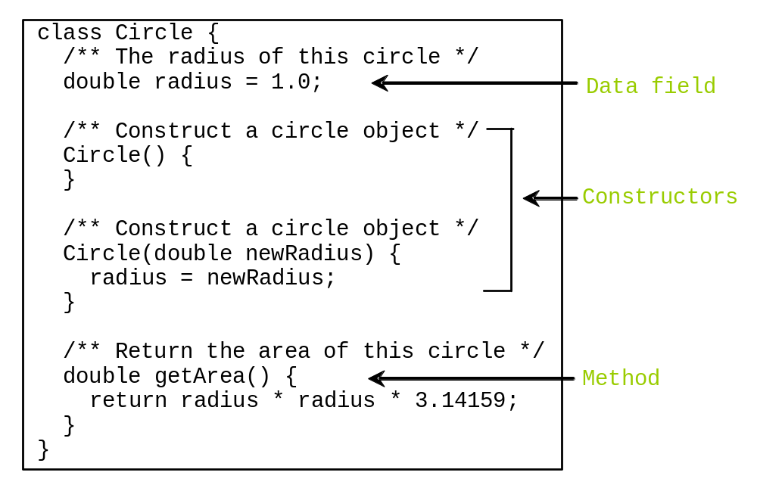
Classes

Slide 6
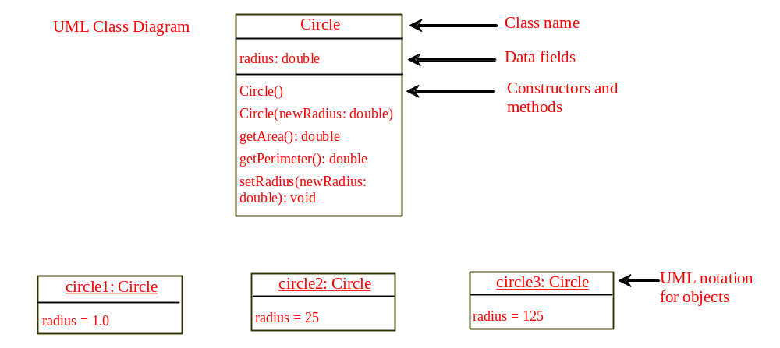
UML Class Diagram

Slide 7
TestSimpleCircle.java
Pages 326-7 Listing 9.1

Slide 8
Constructors
Constructors are a special kind of methods that are invoked to construct objects.
Circle() {
}
Circle(double newRadius) {
radius = newRadius;
}

Slide 9
Constructors, cont.
A constructor with no parameters is referred to as a no-arg constructor.
· Constructors must have the same name as the class itself.
· Constructors do not have a return type—not even void.
· Constructors are invoked using the new operator when an object is created. Constructors play the role of initializing objects.

Slide 10
Creating Objects Using Constructors
new ClassName();
Example:
new Circle();
new Circle(5.0);

Slide 11
Default Constructor
A class may be defined without constructors. In this case, a no-arg constructor with an empty body is implicitly defined in the class. This constructor, called a default constructor, is provided automatically only if no constructors are explicitly defined in the class.

Slide 12
Declaring Object Reference Variables
To reference an object, assign the object to a reference variable.
To declare a reference variable, use the syntax:
ClassName objectRefVar;
Example:
Circle myCircle;

Slide 13
Declaring/Creating Objects in a Single Step
ClassName objectRefVar = new ClassName();
Example:
Circle myCircle = new Circle();
Assign object reference
Create an object

Slide 14
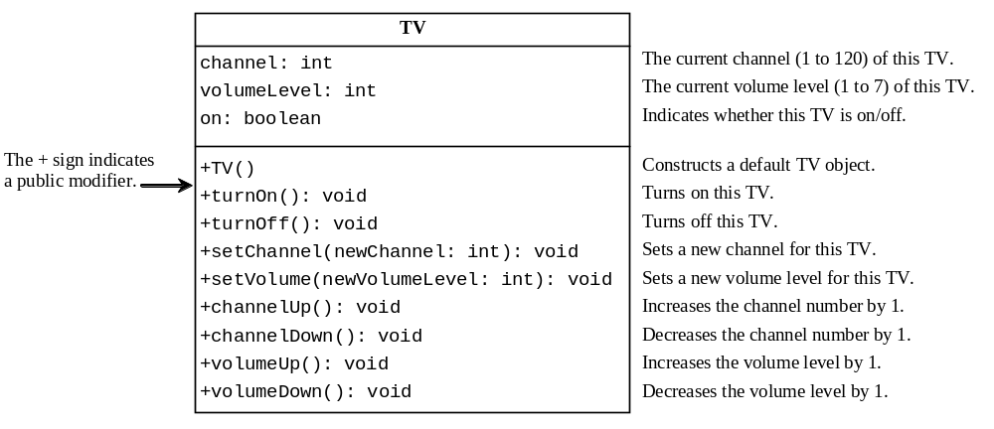
Example: Defining Classes and Creating Objects
TV
TestTV
Run

Slide 15
TV.java/TestTV.java
Pages 329-330 Listing 9.3
Page 330 Listing 9.4

Slide 16
IntellJ – Create a Class
File | New | Java Class

